Slide 1


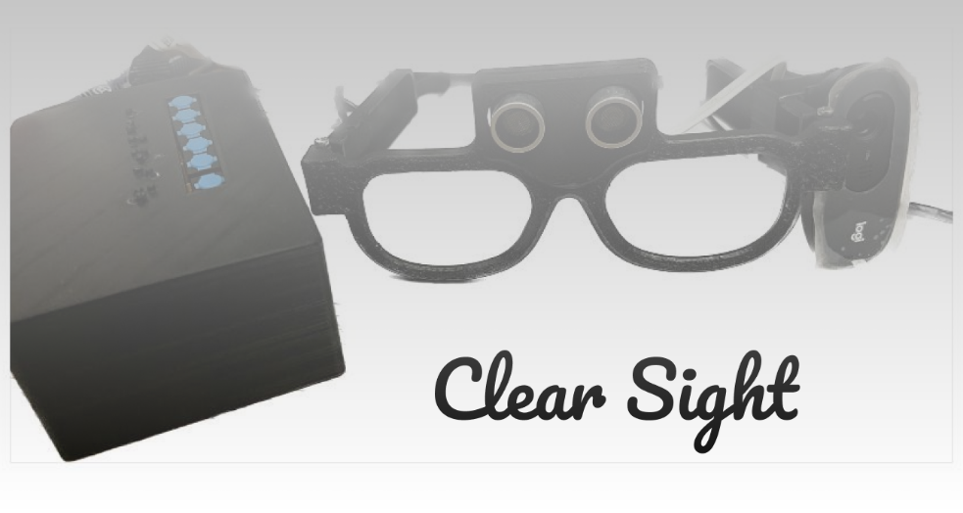



Design and Implementation of Smart glasses for blind people
MODERN UNIVERSITY FACULY OF COMPUTERS AND ARTIFICIAL INTELLIGENCE

Slide 2
Submitted By
Dina Ahmed El Sayed Fathy
Mohamed Gamal Abdallah
Ismail Hany Ismail
Mohamed Omar Abdallah
Ziad Waleed Sayed
Ahmed Sayed Mohamed

Slide 3
Supervised By
Prof. Dr. Gouda Ismail
T.A. Riham Faris

Slide 4


agenda
Introduction
Motivation & Challenges
Related Work
Project Objectives
Hardware Components
System Implementation & Experimental Results
User Guide
Conclusion
Future work

Slide 5
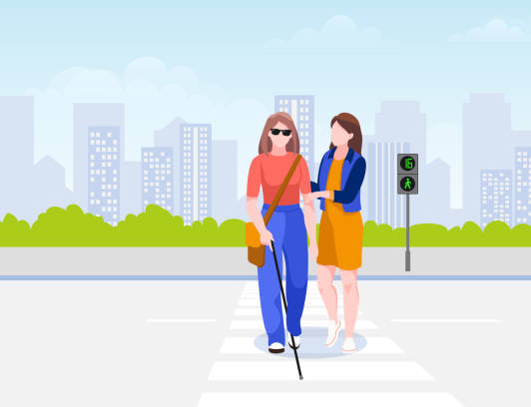
Introduction
Could you imagine how the life of a blind person could be?
Many of them can’t even walk without the help of others.
So, we are hoping that our smart glass could assist them in their life .
Notes:
Dina

Slide 6
agenda
Introduction
Motivation & Challenges
Related Work
Project Objectives
Hardware Components
System Implementation & Experimental Results
User Guide
Conclusion
Future work

Slide 7
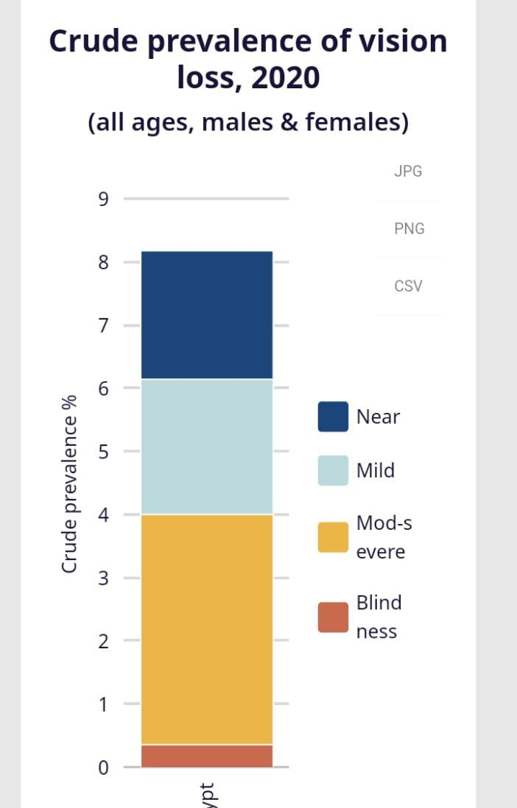
Statistics of blind people in Egypt
In 2020, in Egypt, there were an estimated 8.3 million people with vision loss. Out of these, 370,000 people were classified as blind.
Notes:
https://www.iapb.org/learn/vision-atlas/magnitude-and-projections/countries/egypt/

Slide 8
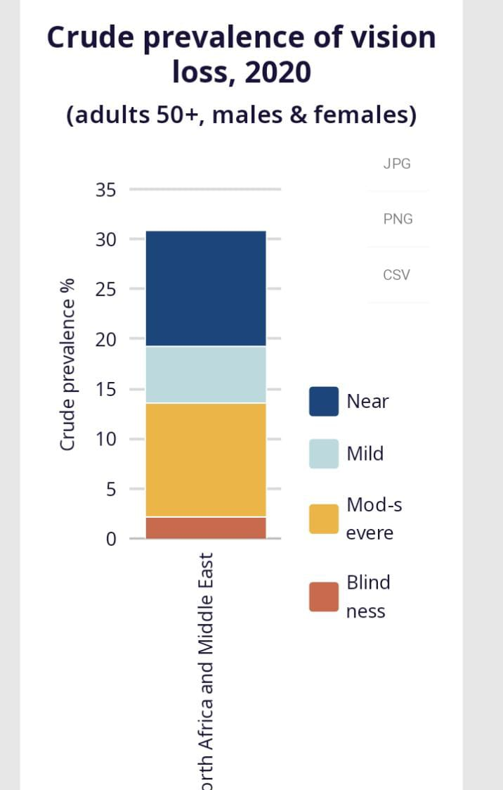
Statistics of blind people in North Africa and Middle East
In 2020 in North Africa and Middle East, there were an estimated 54 million people with vision loss. Of these, 3.1 million people were blind.
Notes:
https://www.iapb.org/learn/vision-atlas/magnitude-and-projections/gbd-regions/north-africa-and-middle-east/

Slide 9
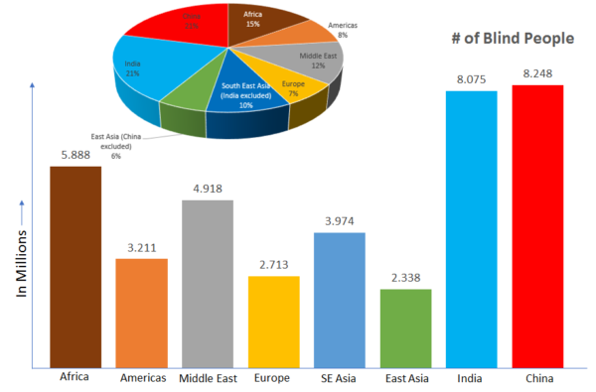
Statistics of Blind People All Over the world
In 2021 we impact organization made Statistics showing the percentage of blindness in all continents of the world
Notes:
WE IMPACT ORGANIZATION

Slide 10

Challenges and Issues Related to Smart Glasses
Hardware and software requirements
Network security and bandwidth.
Overall user experience
Education.
Fashion.
Notes:
Hardware and software requirements
Developing fast, small, lightweight and highly power-efficient processors that can fit in seamless and comfortable frames is a key challenge. Other concerns include cameras that account for tilting and head movement, battery life and eye-tracking capabilities.
Network security and bandwidth. Providing seamless AR experiences based on cloud-hosted services and content requires uninterrupted Wi-Fi availability and high-security standards which is a challenge.
Overall user experience. Manufacturers are still trying to develop a standard on how to best interact with displayed content naturally. This has led to the continued iteration of controls and frame design.
Safety, privacy and regulations. Smart glasses present and face numerous new and unresolved safety challenges. Some concerns such as obstructed peripheral vision, the safety of the devices in dynamic environments, the possibility of recording others without consent, and other such concerns still need to be addressed.
Education. Eyeglasses must continue to serve their purpose, which is to correct and protect vision. In this regard, the public will need to learn how to operate these new tools and adapt to the influx of wireless data.
Fashion. Appearance was a significant hurdle for geeky-looking Google Glass. Smart glasses of the future need to be sleek and stylish.

Slide 11
agenda
Introduction
Motivation & Challenges
Related Work
Project Objectives
Hardware Components
System Implementation & Experimental Results
User Guide
Conclusion
Future work

Slide 12
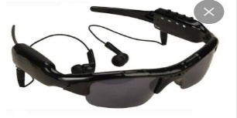
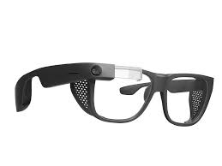
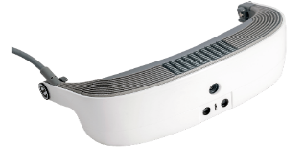
Commercial Smart Glasses
Product / Year | Features | Cons | Price
Al-Amal /2010 | Identify Surrounding objects. Send SMS Allows recording notes and playing voice notes like shopping lists and things to do Flashlight and Qibla guides GPS Translator Emergency Identify Products | Works only on Samsung 4 giga ram or more ,it is preferred to be A71 or A51 or IM12 | $1100
Envision/2013 Built on the enterprise edition of Google Glass. | Read Any Text Describe Scene Detect Light Recognize Cash Detect Colors Find objects, People Tech a Face Discover what is in around you in real time. Call help Language Detection Read Handwritten, Personal notes and Cards. Layout Detection (Heading, Columns) Light Wight(weigh<50 gm in total) water-resistant. | High-Cost | $3,500
eSight/2013 | Equipped with OCR (Optical Character Recognition) A forward-facing camera captures the images and displays them inside the glasses | High-Cost Design isn’t friendly | $5,950

Slide 13
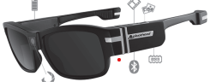
Similar Projects for Smart Glasses-cont
Authors | Title/Year | Features | Cons
Project Team: Yahya Abd El-Hameed Ahmed Ibrahim Waleed Ismail Fawzy El-Ghannam Ahmed Mostafa Hamada Amr Hassan Mohamed El-Shaarawy Ahmed Mohamed Hassan Amer Ahmed Mohamed Hussein Maghraby Academic supervisor: Dr Ahmed El-Abbassy Assisting supervisor: Eng. Hadeer Alim | Smart Glasses for Blind People 2017 | Can recognize images and determine each object in the images Compute the distance between the person and each object | The glasses didn’t have the following: GPS Locator Wireless charging to recharge battery Panic button Sim card slot for data connectivity Roller device at top to generate powers
Maghfirah Ali Tong Boon Tang | Smart Glasses for the Visually Impaired People 2016 | New design of smart glasses that can provide assistance in multiple tasks at a low cost. The design use Raspberry Pi 2 single board computer, a camera, and an earpiece to convey information to the user. | The paper only demonstrate reading task only
Nallapaneni Manoj Kumar , Neeraj Kumar Singh , V. K. Peddiny | Wearable Smart Glass: Features, Applications, Current Progress and Challenges 2018 | The paper shows the possible features of a typical smart glass available in the market. voice recording text preparation video recording location services, data exchange | According to the paper conclusion more improvements are needed for the smart glass to make itself as the best fit in many potential areas.

Slide 14
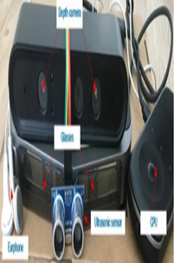
Similar Projects for Smart Glasses-cont.
Authors | Title/Year | Features | Cons
Jinqiang Bai, Shiguo Lian, Dijun LiuPu | Smart guiding glasses for visually impaired people in indoor environment 2017 | Utilizes both the depth sensor and ultrasonic sensor to solve the problems of detecting small obstacles, and transparent obstacles. | Focuses only on the Obstacle Avoidance
S. H. Vardhan, Jalluri Vardhan, Garapati Rakesh | SMART GLASSES FOR BLIND PEOPLE 2021 | It has an in-built sensor in it which spreads ultrasonic waves in the direction the person is going by scanning at most 5-6 meters of 30o range. As soon as the obstacle is detected, the sensor detects it and sends it to the device which generates an automated buzzer voice near the ear. An IR sensor detects the position of the glasses when they fell off to the ground. As soon as it fell down it starts a buzzer that intimate the position to pick it again by the user. | Supporting only English language The maximum distance of capturing the images is between150-300cm. Design need to be more smaller and comfortable to wear.

Slide 15
agenda
Introduction
Motivation & Challenges
Related Work
Project Objectives
Hardware Components
System Implementation & Experimental Results
User Guide
Conclusion
Future work

Slide 16

Project Objective
Our objective is to develop smart glasses for blind individuals ,utilizing sensors,cameras & AI ,to provide real-time feedback, enabling independent navigation and access to visual information.

Slide 17
Features
1) OCR
2) Text Translation
3) Scene Description
10) Recording Notes
9)Target Country/City Detection
4)Age/Gender Reveal
6) Scan QR code.
5) Color Identification
7)Prayer-Time
8)El Qibla Detection
11)Obstacle Detection

Slide 18
agenda
Introduction
Motivation & Challenges
Related Work
Project Objectives
Hardware Components
System Implementation & Experimental Results
User Guide
Conclusion
Future work

Slide 19
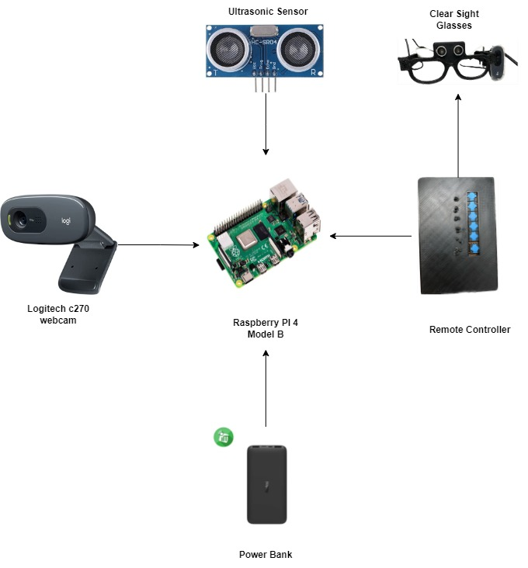
Functional block diagram
Hardware
Notes:
Old one yt8yr

Slide 20
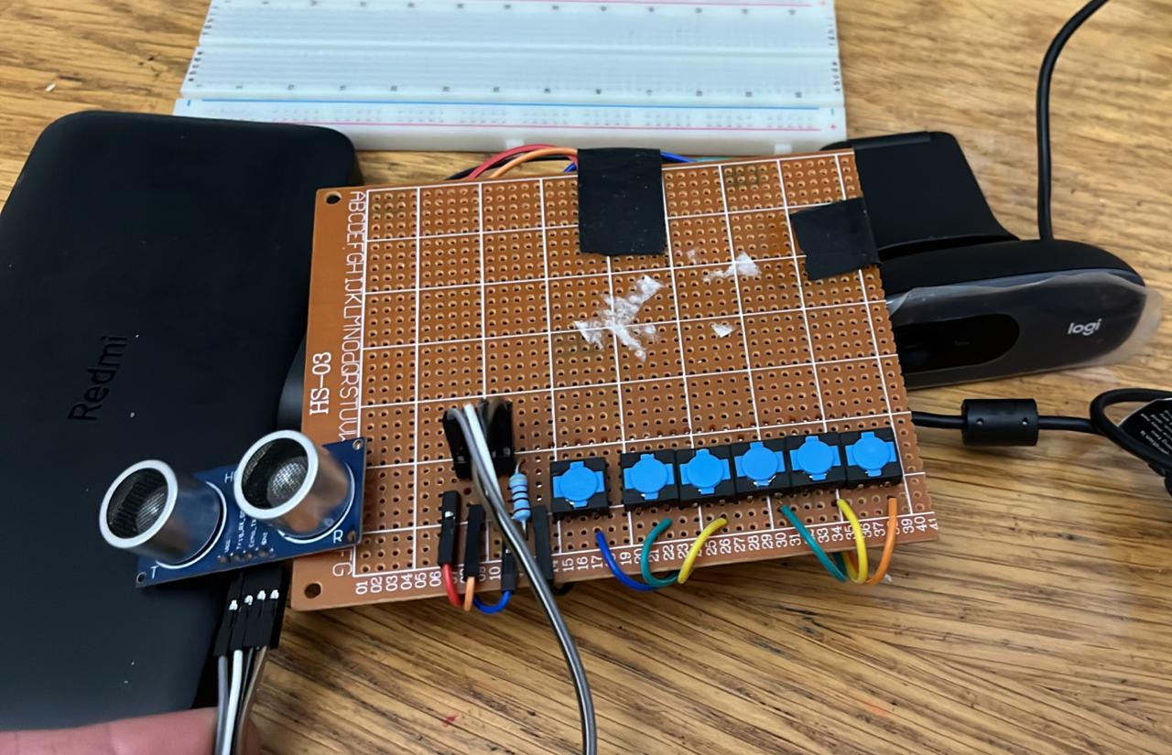
Hardware components
Hardware

Slide 21
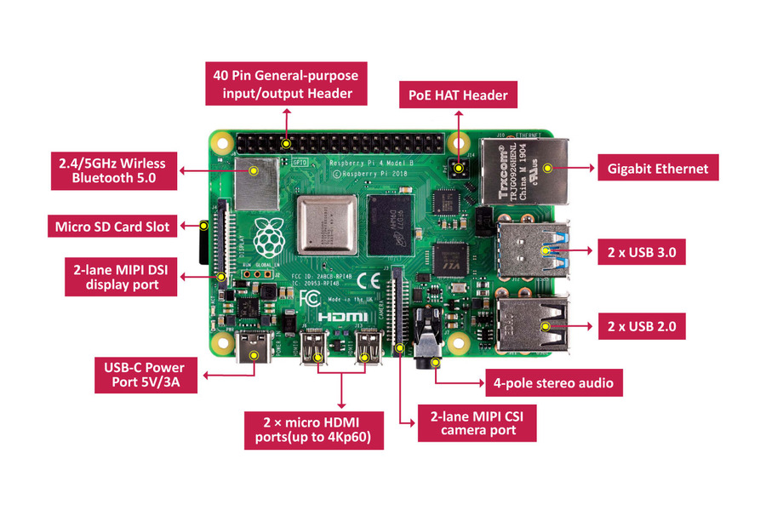
Raspberry Pi 4 Model B
4GB of RAM
Dual-band (2.4GHz and 5.0GHz) IEEE 802.11b/g/n/ac wireless LAN and Bluetooth 5.
Micro-SD card slot for loading operating system and data storage
Used as the brain of smart glasses system designed to assist visually impaired individuals
Is a relatively complex device compared to other microcontrollers or microprocessors
Notes:
Cons
While the Raspberry Pi 4 is a powerful and versatile platform that can be used in a variety of projects, there are some potential downsides to using it in a smart glass system designed for visually impaired individuals. Here are some of the cons to consider:
1. Power consumption: The Raspberry Pi 4 can consume a significant amount of power, which may be a concern for a portable device like smart glasses. Depending on the battery size and other components used in the system, the Raspberry Pi 4 may need to be optimized for power efficiency.
2. Size and weight: The Raspberry Pi 4 is a relatively large and heavy device compared to other microcontrollers or microprocessors, which can be a disadvantage in a wearable device like smart glasses. The size and weight of the Raspberry Pi 4 may need to be balanced against other factors like processing power and connectivity.
3. Cost: While the Raspberry Pi 4 is relatively affordable compared to other computer systems, it may still be more expensive than other microcontrollers or microprocessors that are suitable for this project. Depending on the budget for the project, the cost of the Raspberry Pi 4 may need to be considered carefully.
4. Complexity: The Raspberry Pi 4 is a relatively complex device compared to other microcontrollers or microprocessors, which can make it more challenging to program and integrate into the smart glasses system. Developers may need to have a higher level of expertise in computer programming and hardware design to work with the Raspberry Pi 4.
Overall, while the Raspberry Pi 4 is a powerful and flexible platform that can be used in a smart glass system for visually impaired individuals, there are some potential downsides to consider, particularly related to power consumption, size and weight, cost, and complexity.

Slide 22
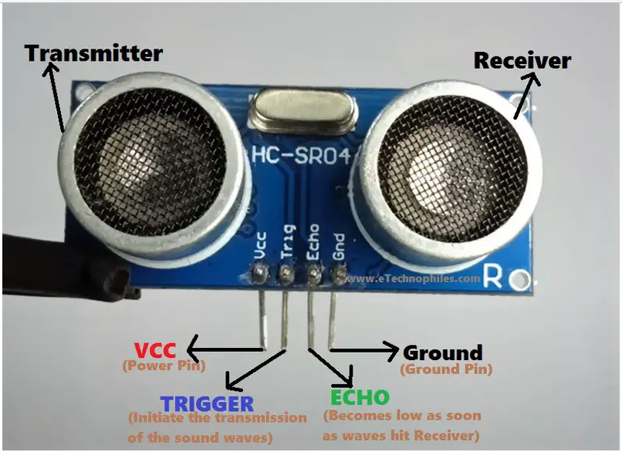
Ultrasonic sensor
Use sound waves to detect distance, the distance should be from 40 cm to 150 cm
Sensitive to changes in the environment, ,such as changes in temperature, humidity, or air pressure, which can affect the accuracy of the sensor.
Operate at frequencies between 20 kHz and 200 kHz
Consume relatively low power.
Notes:
Ultrasonic sensors are electronic devices that use sound waves to detect the presence, distance, or movement of objects. Here are some of the properties of ultrasonic sensors:
Frequency range: Ultrasonic sensors typically operate at frequencies between 20 kHz and 200 kHz, which is above the range of human hearing.
Range: Ultrasonic sensors can detect objects at distances ranging from a few centimeters to several meters, depending on the design of the sensor and the environment in which it is used.
Accuracy: Ultrasonic sensors can provide accurate measurements of distance, typically with a resolution of a few millimeters.
Directionality: Ultrasonic sensors can be designed to emit sound waves in a specific direction, allowing them to detect objects in a particular area.
Sensitivity: Ultrasonic sensors are sensitive to changes in the environment, such as changes in temperature, humidity, or air pressure, which can affect the accuracy of the sensor.
Robustness: Ultrasonic sensors are generally robust and can be used in harsh environments, such as dusty or wet conditions.
Power consumption: Ultrasonic sensors typically consume relatively low power, making them suitable for battery-powered applications.
Overall, ultrasonic sensors are versatile and reliable sensors that can be used in a variety of applications, including distance measurement, object detection, and motion sensing. Their properties make them particularly useful in environments where other sensors, such as optical or infrared sensors, may not be effective
Reference:HC-SR04 Ultrasonic Sensor Pinout, Working & Arduino Projects (etechnophiles.com)

Slide 23
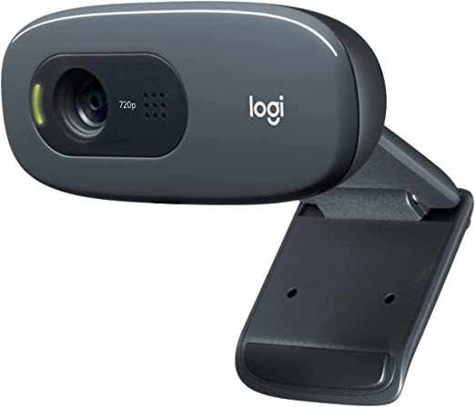
Hardware
Logitech C270 Hd Webcam
Resolution (max.): 1280 x 720
Can be easily connected to the Raspberry Pi using a USB port
Provides a cost-effective solution for adding video streaming to Raspberry Pi projects.

Slide 24
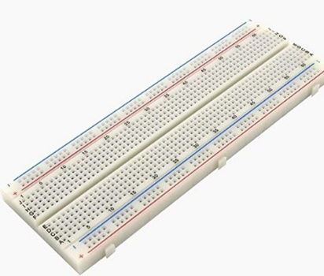
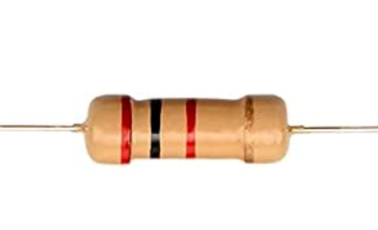

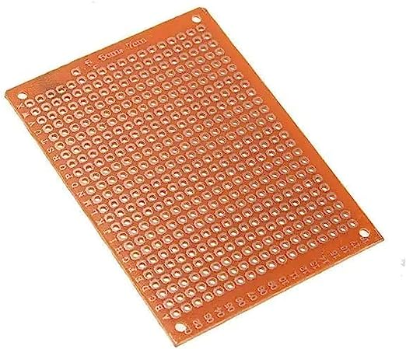
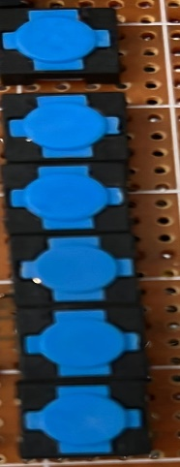
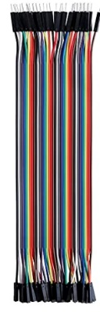
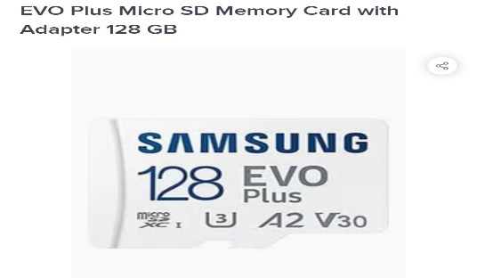

Hardware
Other Components
Resistor 1k Ω
Resistor 2kΩ
Breadboard
PCB HS-03
Buttons
Jumper Wires
SD Card 128GB

Slide 25
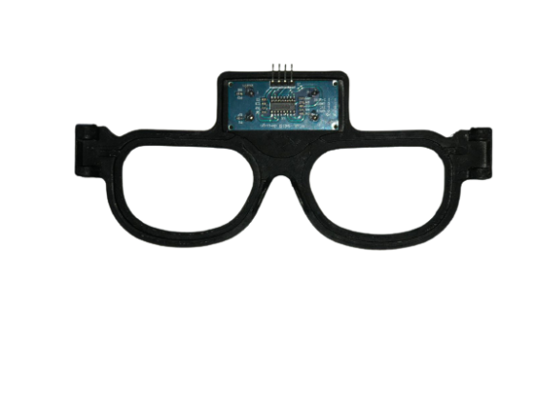
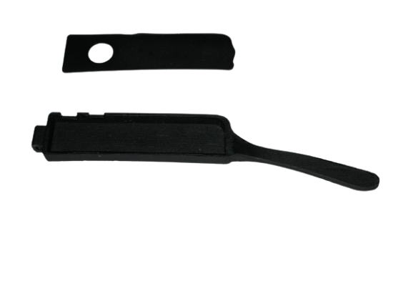
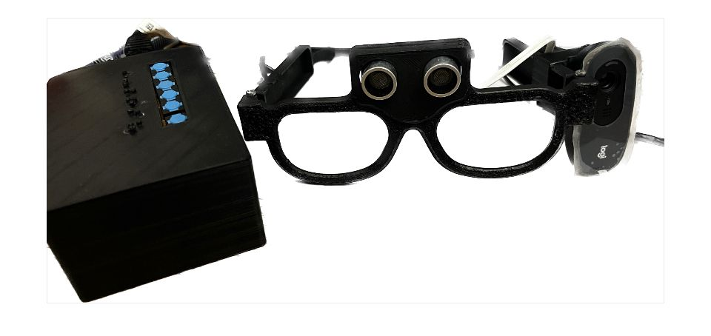
Design
Clear Sight Glasses Design

Slide 26
agenda
Introduction
Motivation & Challenges
Related Work
Project Objectives
Hardware Components
System Implementation & Experimental Results
User Guide
Conclusion
Future work

Slide 27
Optical character recognition (OCR)
Known as text recognition technology
Convert any kind of image containing text into machine readable text data.
Notes:
Optical character recognition (OCR), also known as text recognition technology, converts any kind of image containing written text into machine-readable text data. OCR allows you to quickly and automatically digitize a document without the need for manual data entry. That’s why OCR is commonly used for business flow optimization and automation. The output of OCR is further used for electronic document editing, and compact data storage and also forms the basis for cognitive computing, machine translation and text-to-speech technologies.
There are different types of OCR depending on the tasks they solve:
Intelligent Word Recognition (IWR) is used for the recognition of unconstrained handwritten words instead of recognition of individual characters.
Intelligent Character Recognition (ICR) is a more advanced form of OCR based on updating algorithms to gather more data about variations in hand-printed characters.
Optical Word Recognition (OWR) scans typewritten text word by word.
Optical Mark Recognition (OMR) is used to identify the information that people mark on surveys, tests, etc.
Let’s find out how OCR works. The functioning of the traditional optical character recognition system consists of three stages: image pre-processing, character recognition, post-processing.

Slide 28
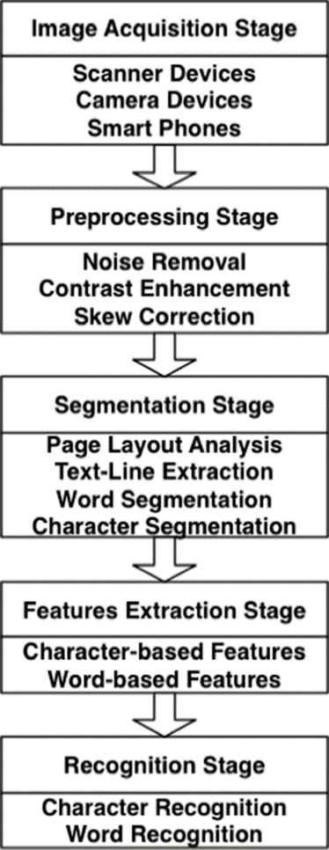
How OCR works?
Notes:
Optical Character Recognition OCR is an automated process by which a text presented in a digital image is extracted and converted to an editable text [37]. In the literature, OCR systems can operate in two modes, either on-line or off-line [8]. The on-line OCR systems extract a set of pre-defined features (e.g. speed of drawing text and curvature tracking) immediately while users are writing. These systems are widely adopted in smartphones and tablets. On the other hand, the off-line systems recognize page segments, lines, words, and characters of stored scanned document images.
Figure 1 [14]. Image acquisition is the first stage which aims to acquire document images using either scanners or digital cameras. Then, a set of preprocessing methods are applied to the input scanned document images to handle the common problems that appear after the scanning process such as noise, line skew, and text slant. The preprocessed/cleaned document images are then passed to the segmentation stage in which individual segments such as paragraphs, lines, words, and characters or sub-characters are extracted. The feature extraction stage performs analysis on each segmented component through extracting a set of discriminative features to be utilized later in recognizing those segments. At last, the classification/recognition stage exploits the output of the feature extraction stage (e.g. feature vector) to recognize the characters and sub-characters segmented.

Slide 29
Preprocessing phase
1.Image Inversion: The colors of the image are inverted, done to enhance the text present in the image specially when text is lighter than background, text becomes more prominent.
2.Gray-Scale Conversion: Done to reduce the color space and simplify the image.
3.Binarization: Done to separate the foreground (text) from the background of the image.
4.Noise Removal: This is done to remove any small unwanted details that may hinder the OCR process.
Notes:
Libraries

Slide 30

English OCR

Slide 31
Algorithm-English ocr
Step One
Import the required libraries: cv2, pytesseract, pyttsx3, and numpy.
Step Two
Capture Image and define the path to the image file to be processed.
Step Three
Read the image file using OpenCV's imread() function and store it in a variable.
Step Five
Perform OCR using pytesseract.image_to_string()
Step Six
Step Seven
End of the algorithm.
Step Four
Apply image processing techniques to the image
Output the text as audio using pyttsx3.init() and pyttsx3.speak() functions

Slide 32
Experimental Results

Slide 33
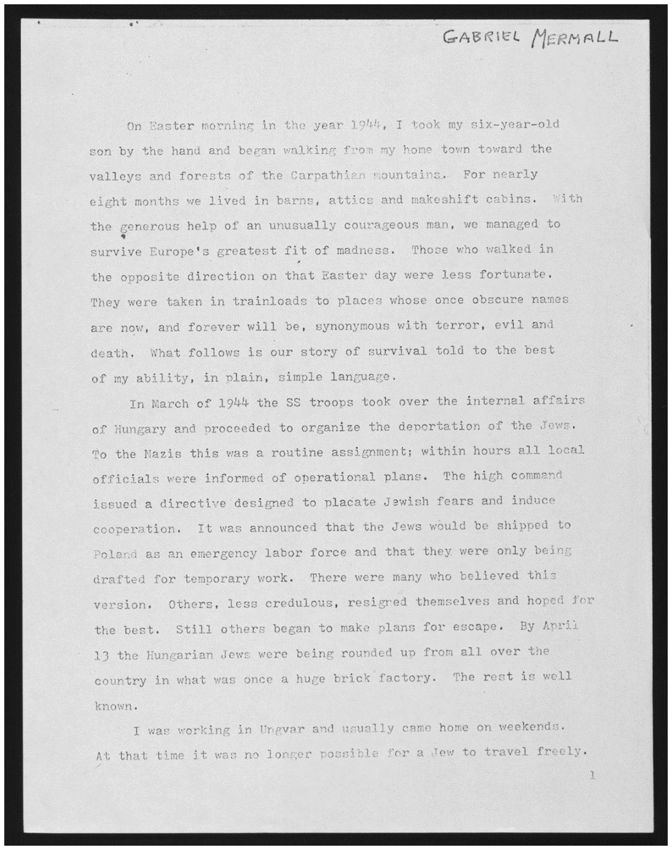
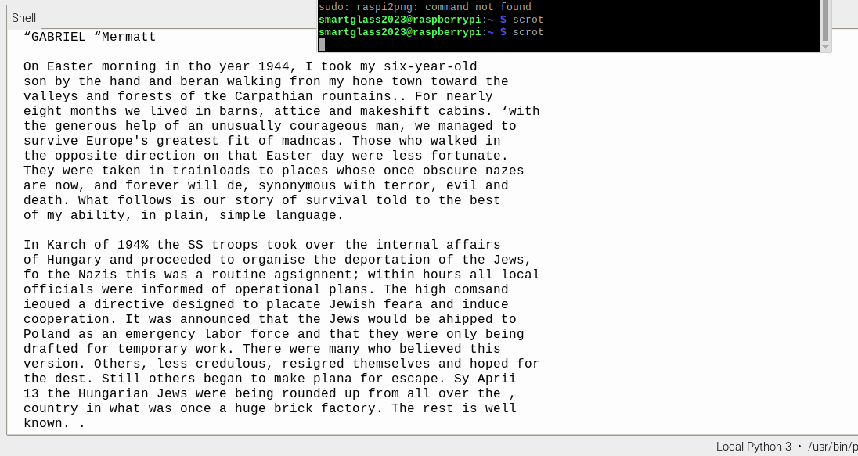
Input
Output

Slide 34
Arabic OCR

Slide 35
Arabic Reshaper vs Bidi Algorithm
Arabic Reshaper | Bidi Algorithm
It focuses on reshaping Arabic characters, considering ligatures and complex script rules, to ensure proper rendering and readability of Arabic text. | Is crucial for maintaining the correct visual order and layout of mixed bidirectional text, such as Arabic and non-Arabic scripts, ensuring coherent and readable display of multilingual content.
Together, they contribute to the overall accuracy, readability, and visual presentation of Arabic OCR outputs.

Slide 36
Algorithm-Arabic ocr
Step One
Read the input image using OpenCV
Step Two
Apply Image Processing Techniques to the input image.
Step Three
Perform OCR using pytesseract.image_to_string() with the Arabic language specified
Step Four
Reshape the OCR result using arabic_reshaper.reshape() and get_display() from bidi.algorithm to correct the Arabic text shaping and display it correctly
Step Five
Convert the text to speech using gTTS() with the Arabic language specified
Step Six
Reshape the Arabic voice output using arabic_reshaper.reshape() and get_display() from bidi.algorithm to correct the Arabic text shaping for the voice output
Step Seven
Initialize pygame mixer for playing the audio file
Step Eight
Load the audio file using pygame.mixer.music.load()
Step Nine
Play the audio file using pygame.mixer.music.play()

Slide 37
Experimental Results

Slide 38
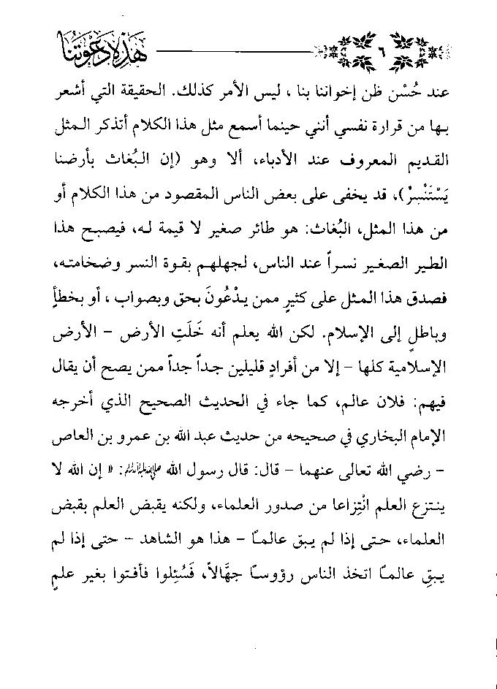
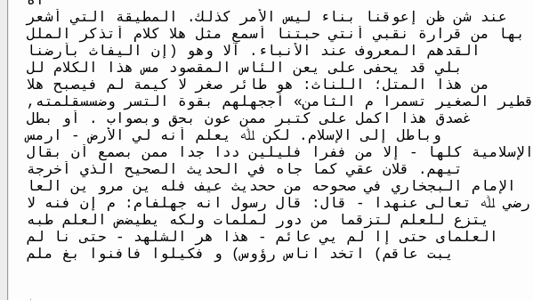
Input
Output

Slide 39
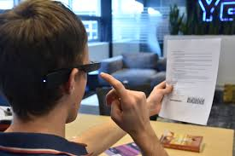
Text Translation from English to Arabic

Slide 40
Google translate API
API enables developers to integrate language translation capabilities into their Python applications, allowing for seamless multilingual functionality.
01
It supports text translation, language detection, and transliteration.
02
The API covers over 100 languages and utilizes advanced machine learning algorithms for accurate translations.
03

Slide 41

How Google Translate API Works?
Works by sending text input to Google’s cloud-based translation service, which utilizes advanced machine learning algorithms to analyze and translate the content into the desired target language

Slide 42
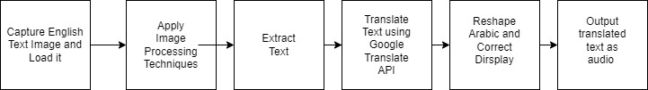
Block Diagram

Slide 43
Algorithm
Step One
Load an English image file using OpenCV and assign it to the variable `img`.
Step Two
Apply image processing techniques to improve the OCR results:
Step Three
Use the Tesseract OCR engine to extract text from the processed image using the `pytesseract.image_to_string()` function and assign the result to the variable `ocr_result`.
Step Four
Use the Google Translate API to translate the extracted English text to Arabic using the `translator.translate()` function and assign the result to the variable `translatedar`.
Step Five
Use the Arabic reshaper library to reshape the Arabic text using the `arabic_reshaper.reshape()` function and assign the result to the variable `reshaped_text`.
Step Six
Use the Bidi algorithm to correct the display of the reshaped Arabic text using the `get_display()` function and assign the result to the variable `display_text`.
Step Seven
Output Translated text as voice using gtts
Step Eight
End the code.

Slide 44
Experimental Results

Slide 45
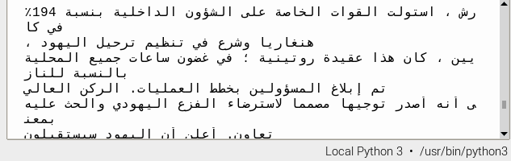
Input
Output

Slide 46
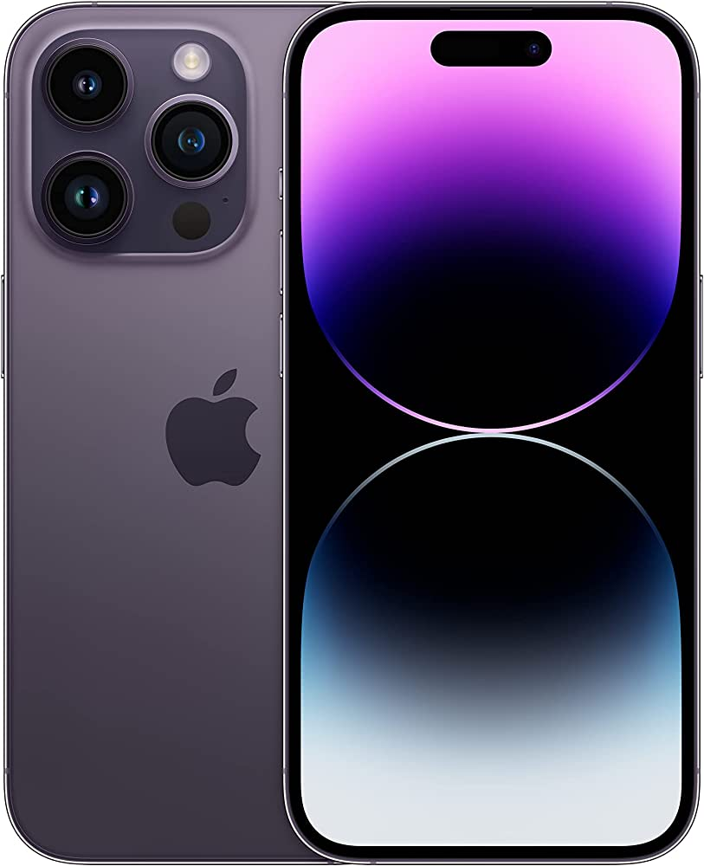

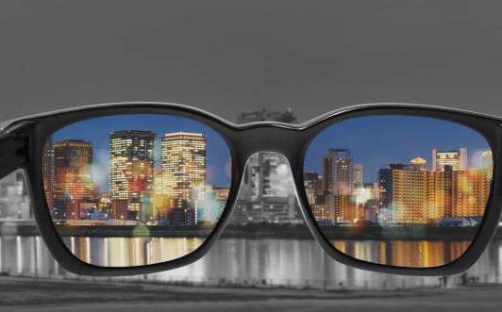
Scene Description
Notes:
Blind helper (object detection ):Smart glasses help blind people to interact with their surrounding environments by detecting objects

Slide 47
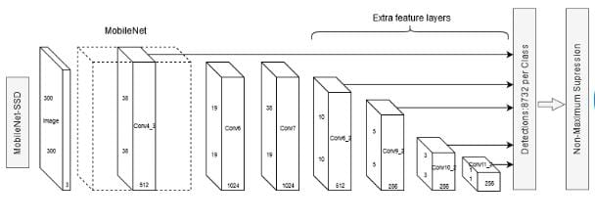
MobileNet SSD
Is an object detection algorithm that combines the Single Shot Detector (SSD) architecture with a lightweight neural network called MobileNet.
Notes:
The combination of MobileNet and SSD makes MobileNet SSD an efficient and accurate object detection algorithm suitable for real-time applications on mobile and embedded devices with limited computing resources.
MobileNet SSD uses a convolutional neural network (CNN) architecture. The MobileNet part of the network is a type of CNN designed to be computationally efficient and lightweight, making it well-suited for deployment on mobile and embedded devices with limited resources. The SSD part of the network is a type of object detection architecture that uses a single feedforward CNN to directly predict the class scores and bounding box offsets for a set of predefined default bounding boxes at multiple scales and aspect ratios.
The MobileNet SSD (Single Shot MultiBox Detector) is an object detection model based on the MobileNet architecture. It works by utilizing a deep neural network to detect objects in images in a single pass.
The architecture of MobileNet SSD can be summarized as follows:
1. MobileNet Base Network: The model starts with a base MobileNet network, which is a lightweight convolutional neural network designed for efficient computation on mobile and embedded devices. This base network performs feature extraction from the input image.
2. Convolutional Layers: On top of the base network, several additional convolutional layers are added to further refine the features and extract higher-level representations.
3. Multi-scale Feature Maps: The model generates feature maps at different spatial resolutions, capturing objects at various scales. These feature maps are obtained by applying convolutional layers at different depths in the network.
4. Object Detection: At each location in the feature maps, the model predicts a set of bounding boxes and their corresponding class labels. This is done using a set of convolutional layers with anchor boxes, which are pre-defined boxes of different sizes and aspect ratios.
5. Non-Maximum Suppression: To eliminate redundant and overlapping bounding box predictions, a non-maximum suppression algorithm is applied. It selects the most confident bounding boxes and removes the rest based on their intersection-over-union (IoU) overlap.
The MobileNet SSD architecture is designed to balance accuracy and efficiency, making it suitable for real-time object detection applications on resource-constrained devices.
The main difference between MobileNet and CNNs is that MobileNet is designed to be lightweight and efficient, while CNNs can be more flexible and powerful but may require more computational resources. MobileNet sacrifices some accuracy and flexibility for speed and efficiency, making it a good choice for mobile and embedded devices with limited processing power and memory.

Slide 48
WHY WE CHOSE MOBILENET SSD ?
MobileNet SSD is a good choice for embedded vision applications on the Raspberry Pi where efficiency and real-time performance are priorities
Compared to SSD and YOLO, MobileNet SSD requires fewer computational resources, making it well-suited for deployment on the Raspberry Pi.

Slide 49
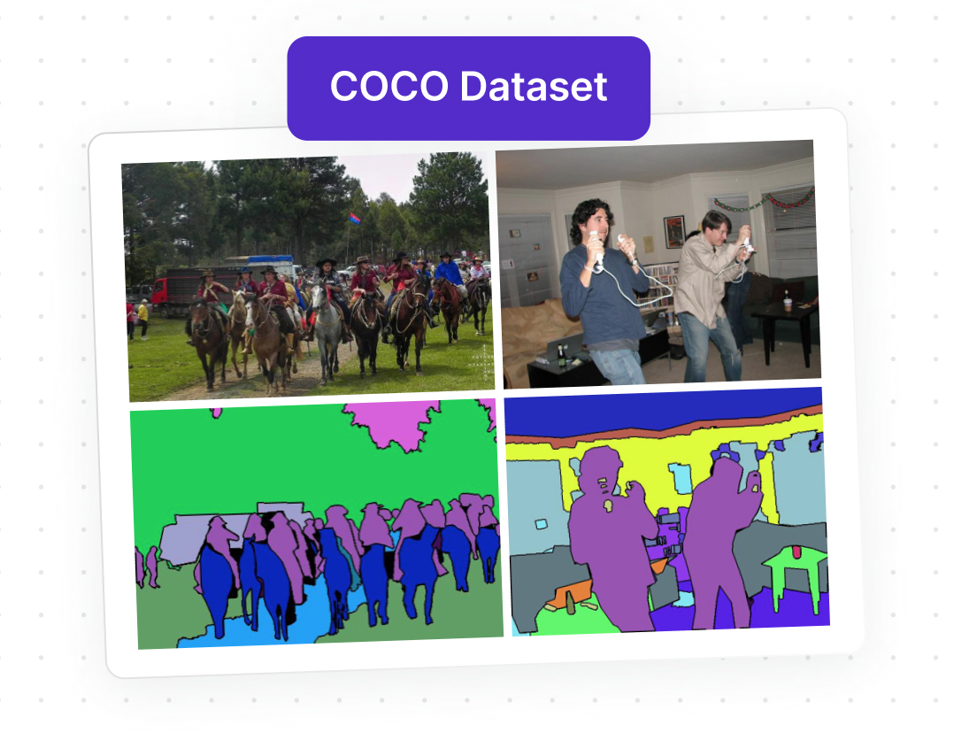
Coco Data set
Widely used in computer vision research and
Is a large-scale object detection, segmentation, and captioning dataset. COCO has several features:
Object segmentation
Recognition in context
Super pixel stuff segmentation
330K images (>200K labeled)
1.5 million object instances
80 object categories
91 stuff categories
5 captions per image
250,000 people with keypoints

Slide 50
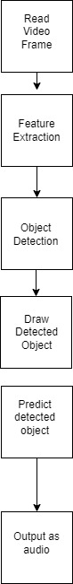
Block Diagram
Notes:
The code starts by reading a video frame from the input stream (webcam in this case).
The video frame undergoes pre-processing, which may involve resizing, normalization, or other transformations to prepare it for feature extraction.
Feature extraction is performed to capture important visual information from the pre-processed video frame.
Object detection is conducted using the extracted features to identify and locate objects within the frame.
Detected objects are visually represented by drawing bounding boxes or other annotations on the video frame.
Prediction is made based on the detected objects, which could involve further analysis or decision-making based on the specific application.
The updated video frame with the drawn objects is displayed.
The process continues by looping back to read the next video frame, repeating the pre-processing, feature extraction, object detection, drawing, prediction, and visualization steps.
The loop continues until the code is terminated or an exit condition is met.

Slide 51
Algorithm
Step One
Import necessary libraries: cv2, numpy, and pyttsx3
Step Two
Load the class names from the coco.names file and create a detection model( mobile net ssd) using the pre-trained weights and configuration file
Step Three
Define a function called getObjects that takes an image value as input and detects the objects in the image using the detection model.
Step Four
The function returns the image with the detected objects drawn on it and a list of object information, such as the object's bounding box and class name.
Step Five
Use pyttsx3 to provide an audio output of the detected object information.
Step Six
End Algorithm

Slide 52
Experimental Results

Slide 53
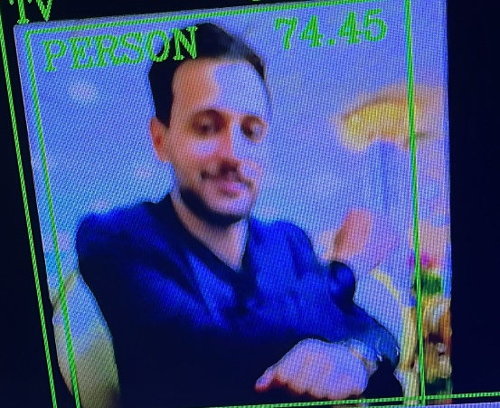
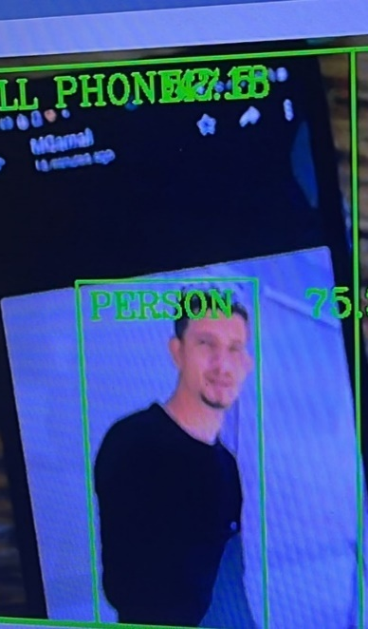
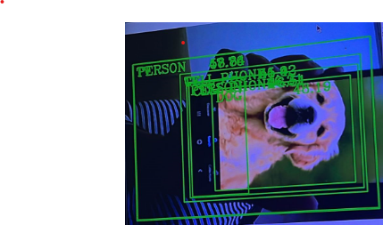
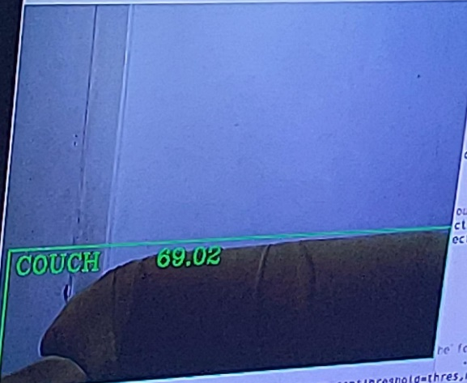
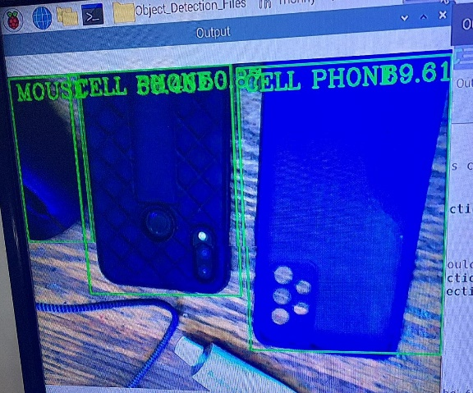
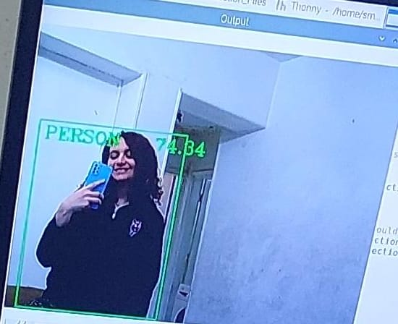

Slide 54

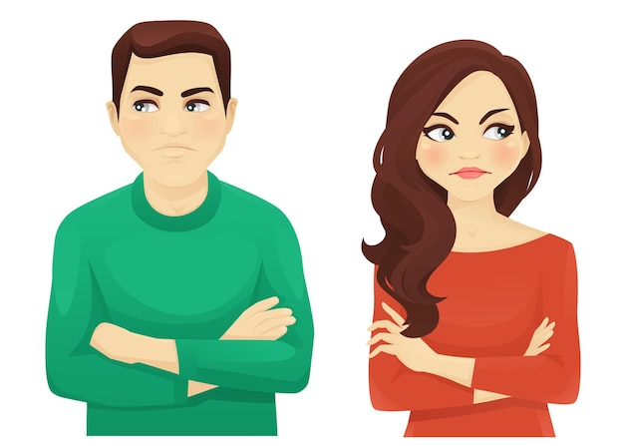
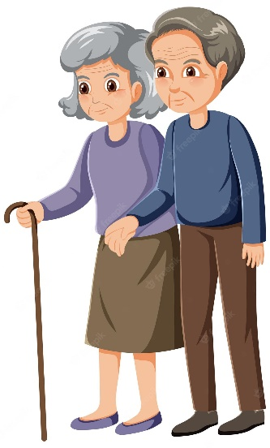
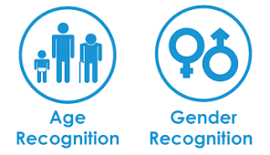
Age/Gender Reveal

Slide 55

Caffe (Convolutional Architecture for Fast Feature Embedding)
Is written in C++, but it has interfaces in Python, MATLAB, and command line.
Known for its efficiency in training and deploying deep neural networks, including CNNs.
It provides a programming interface and tools for building, training, and deploying deep learning models.
It is fast, scalable, and easy to use.
Notes:
In the previous code, the Convolutional Neural Network (CNN) is used as a type of deep learning architecture that is used in the training of the face detection model. The CNN is utilized through the use of the Caffe framework, which is a deep learning framework that can be used to build and train deep neural networks.
The term DNN, which stands for Deep Neural Network, is used interchangeably with CNN in the code. This is because CNN is a type of DNN that is particularly well-suited for image classification and object detection tasks, which are the types of tasks being performed in the code.
Therefore, the use of the Caffe framework in the code allows for the implementation of CNNs/DNNs for the purposes of face detection, age estimation, and gender classification.

Slide 56
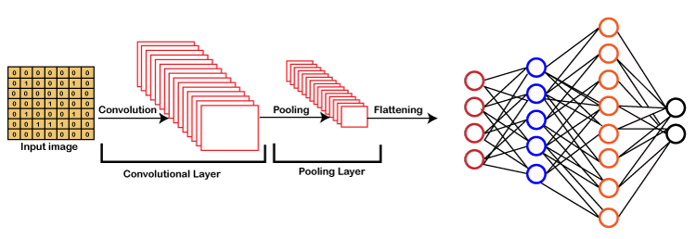
convolutional neural network (CNN)
Special type of feed-forward artificial neural network commonly used in image recognition and computer vision tasks.
Composed of multiple building blocks ,such as convolution layers, pooling layers and is designed to automatically learn spatial hierarchies of features through a backpropagation algorithm.
Notes:
Age/Gender
A feed-forward artificial neural network is a type of neural network where the information flows only in one direction, from the input layer through the hidden layers to the output layer. The input data is multiplied by a set of weights and passed through an activation function in each layer to produce an output. The weights in the network are learned during the training process using backpropagation, where the error between the predicted output and the actual output is propagated backwards through the network to adjust the weights.
Pooling layers in CNN are used to reduce the spatial dimensions (height and width) of the input tensor by downsampling, while preserving the depth. Pooling layers help to reduce the computational complexity of the model, control overfitting, and introduce some translation invariance to small variations in the input image.
Convolutional layers are responsible for learning and detecting patterns or features in the input image such as edges, textures, and shapes. Multiple convolutional layers can be stacked together to learn more complex features as the network goes deeper. The size of the kernel, the number of filters, and the stride can be adjusted to control the size and complexity of the learned features.
In CNN, the convolutional layers use filters to automatically learn spatial hierarchies of features from input data, such as images, through a process called backpropagation algorithm. This allows the network to learn and identify more complex patterns and features as the information flows through the layers, and make better predictions or classifications.
1. Input Layer: The input layer receives the input data, typically an image, and passes it forward for further processing.
2. Convolutional Layers: Convolutional layers are the core building blocks of CNNs. They consist of multiple filters or kernels that convolve over the input image. Each filter performs element-wise multiplication and summation operations on a small region of the input, known as the receptive field. The filters learn to extract different features from the input, such as edges, textures, and patterns, by sliding across the image and applying convolution operations. The output of each filter is referred to as a feature map or a convolutional feature.
3. Activation Function: After the convolution operation, an activation function (e.g., ReLU - Rectified Linear Unit) is applied element-wise to introduce non-linearity. The activation function helps in learning complex relationships between the extracted features.
4. Pooling Layers: Pooling layers reduce the spatial dimensions of the input, decreasing the computational complexity while retaining important features. Common pooling techniques include max pooling, which selects the maximum value within a region, and average pooling, which calculates the average value within a region.
5. Fully Connected Layers: Fully connected layers, also known as dense layers, are responsible for making predictions based on the learned features. The outputs from the previous layers are flattened into a 1D vector and connected to a series of fully connected layers. These layers perform operations involving weights and biases, gradually transforming the input into the desired output shape.
6. Output Layer: The output layer produces the final predictions based on the task at hand, such as image classification or object detection. The number of nodes in the output layer corresponds to the number of classes or categories in the problem domain.

Slide 57

models
age_deploy.prototxt: Age discrimination network configuration file.
age_net.caffemodel :Model file for age discrimination network
gender_deploy.prototxt:Model file of the geneder discrimination network
opencv_face_detector.pbtxt:Profile of face recognition network
opencv_face_detector_unit8.pb: A model file for a face recognition network
Notes:
All of the models mentioned are examples of deep neural networks (DNNs), and specifically, they use variations of convolutional neural network (CNN) architecture.
The age_deploy.prototxt, gender_deploy.prototxt, and opencv_face_detector.pbtxt are all configuration files that define the architecture and structure of the neural network, while the age_net.caffemodel, gender_net.caffemodel, and opencv_face_detector_unit8.pb are trained model files that contain the learned parameters and weights of the network.
1. age_deploy.prototxt: This file is the configuration file for the age discrimination network. It defines the architecture and parameters of the network. The prototxt file specifies the layers, their types (e.g., convolutional, pooling), sizes, and connectivity, enabling the construction of the network. It contains information about the input and output layers, activation functions, and other configuration details required to define the network's structure.
2. age_net.caffemodel: This file contains the trained model parameters for the age discrimination network. During the training process, the network learns to assign appropriate weights to the connections between neurons to make accurate age predictions. The caffemodel file stores these learned parameters, allowing the network to make age predictions on new input data without going through the training process again.
3. gender_deploy.prototxt: Is the model file for the gender discrimination network.Similar to age_deploy.prototxt, it defines the architecture and configuration of the gender discrimination network.It specifies the layers, connectivity, and other necessary information to construct the network for predicting the gender of input images.
4. opencv_face_detector.pbtxt:This file is the profile or configuration file for the face recognition network provided by OpenCV.It describes the structure and settings of the face detection model.The pbtxt file contains information about the layers, their parameters, and the necessary preprocessing steps required for accurate face detection.
5. opencv_face_detector_uint8.pb: The opencv_face_detector_uint8.pb file is a model file for the face recognition network. It contains the trained weights and biases for the face detection model. The model uses a deep learning architecture, such as a CNN, to identify and locate faces in images or videos.
These files collectively provide the necessary components for age and gender discrimination and face detection tasks. The configuration files define the network architecture and parameters, while the model files store the trained weights for making accurate predictions or detections.

Slide 58
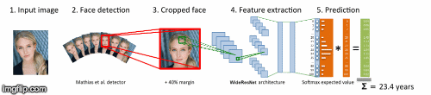
BLOCK DIGRAM
Notes:
The script first loads the deep learning models for face detection, age classification, and gender classification. It then processes the video stream frame by frame, and for each frame, it calls the highlightFace function to detect faces using the face detection model.
For each detected face, the script extracts the face region from the frame, and passes it to the age and gender classification models. It then prints the predicted age and gender to the console, and draws a rectangle around the face with the predicted age and gender label.
The predicted age and gender labels are also displayed in a window titled "Detecting age and gender".
The code uses the OpenCV library and dnn module to implement the deep learning models and for image processing. It also uses the argparse module for handling command-line arguments.

Slide 59
Algorithm
Step One
Import the necessary libraries including OpenCV, Math, and argparse.
Step Two
Step Four.
Define the paths to the pre-trained models for face detection, age prediction, and gender classification as well as their corresponding prototxt files.
Step Five
Load the pre-trained neural network models using cv2.dnn.readNet.
Step Six
Read the input image or video frame and highlight the detected faces using the highlightFace function
Step Seven
For each face detected, extract the face region, pass it through the pre-trained age and gender detection models, resulting with age and gender info using Pyttsx3 as audio
Define a function, highlightFace, takes in a pre-trained neural network for face detection, an input image,returns an image with highlighted face boxesStep

Slide 60
Experimental Results

Slide 61
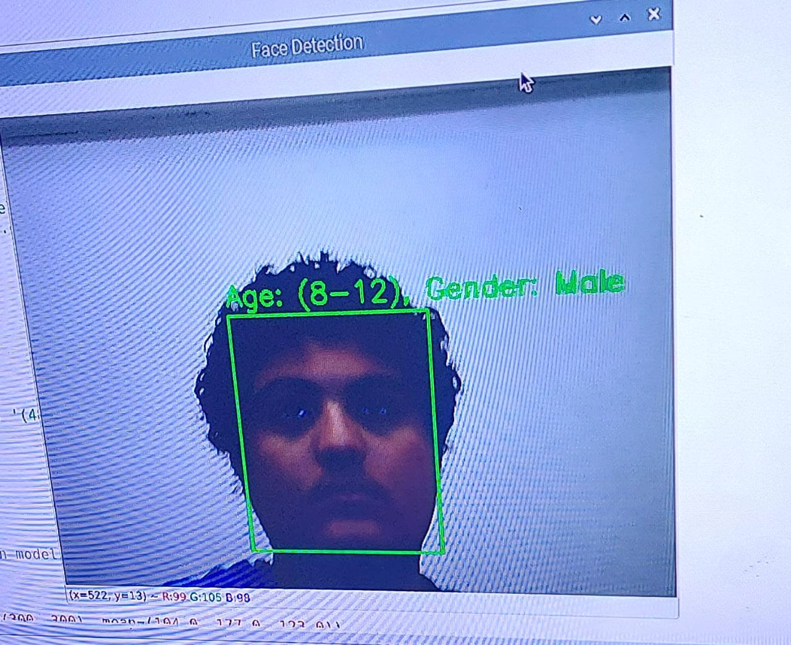
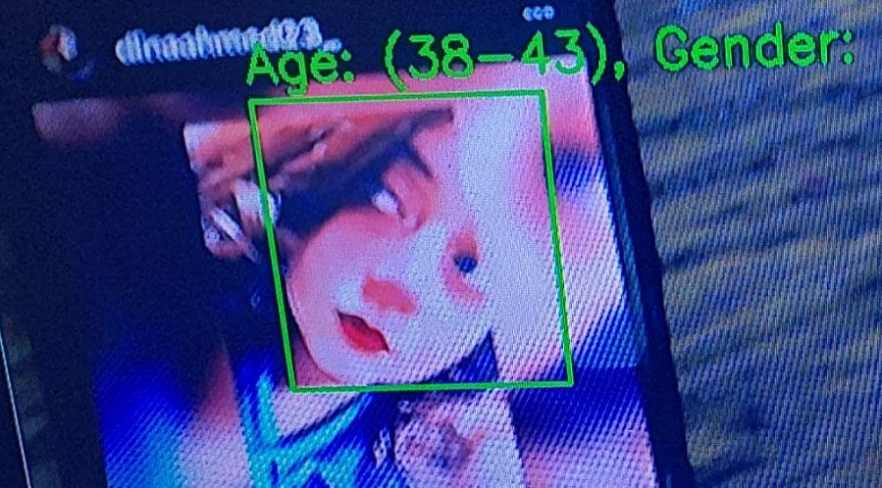


Slide 62




Slide 63



Color Identification

Slide 64

Hue,Satuartion,Value(HSV) Model
Is a color model used in image processing and computer vision.
It represents color using three values which are Hue ,Saturation &Value.
The Hue represents the color, Saturation represents the greyness, and Value represents the brightness.
Hue range is [0,360], Saturation range is [0,255], and Value range is [0,255]
Notes:
Color identification block
1)Hue: It is the dominant wavelength of color and represented as a degree on color wheel, ranging from 0 to 360.The value 0 is for red,120 is for green and 240 is for blue. The hue represents the color itself and it is independent of brightness.
2) Saturation: It is the purity of color, representing the amount of white light mixed with hue, saturation ranges from 0 to 100 percent, where 0 means no color and 100 means pure color.
3) Value: It is the brightness of color ranging from 0 to 100 percent ,where 0 means black and 100 means the brightest color
Color distribution RGB space and HSV space (A is RGB space; B is HSV... | Download Scientific Diagram (researchgate.net)
Understanding Hue, Saturation & Lightness (HSL) for Photo Retouching • Giggster Guide

Slide 65

Hue
Red ranges between 0 and 60 degrees.
Yellow ranges between 61 and 120 degrees.
Green ranges between 121-180 degrees.
Cyan ranges between 181-240 degrees.
Blue ranges between 241-300 degrees.
Magenta ranges between 301-360 degrees.
Notes:
Color spaces (RGB vs HSV) - Which one you should use? - HubPages

Slide 66

Saturation
The saturation range is typically defined from 0% to 100%.
A saturation value of 0% represents a completely grayscale color,
A saturation value of 100% represents the most vibrant and fully saturated version of the color.
Intermediate saturation values represent varying degrees of color intensity and purity.

Slide 67

Value
The value range is also typically defined from 0% to 100%.
A value of 0% represents the darkest version of the color .
A value of 100% represents the brightest version of the color.
Intermediate value levels represent different levels of brightness or lightness within the color spectrum.

Slide 68
Why HSV not RGB?
HSV is preferred over RGB in color identification due to its intuitive representation, robustness to lighting variations, and simplified color range specification, which aligns well with human perception and natural color relationships.

Slide 69

Block Diagram

Slide 70
Algorithm
Step One
Step Two
Initialize an offline text to speech engine using pyttsx3.
Step Three
Open the camera
Step Four
In an infinite loop, capture frames from the camera, convert each frame to HSV color space, and identify colors in each frame by iterating over the colors dictionary.
Step Five
Import necessary libraries including OpenCV, Numpy, pyttsx3 and Threading.
If enough pixels match the color range, the color is detected. In this case, print the color, add a text overlay to the frame with the color name, draw a circle at the center of the frame and use threading to speak the color name

Slide 71
Experimental Results

Slide 72



Slide 73
Algorithm
Step One
Step Two
Step Four
Set up the GPIO pins and initialize the text-to-speech engine.
Create a function for object detection that calls the distance measurement function. Based on the measured distance, determine if an object is too close.
Step Three
Create a function to measure the distance using the ultrasonic sensor by sending a pulse and measuring the duration.
If the object is too close, use the text-to-speech engine to convert a predefined message, such as "Object is too close," into speech output

Slide 74
Experimental Results

Slide 75


Slide 76

QR code

Slide 77
ZBAR Library
Provides functionality to scan & decode QR Codes
Wrapped with pyzbar Python library

Slide 78

Block Diagram
Notes:
1. Image Input: To scan a QR code, you need to provide an image or a frame containing the QR code. This image can be a file on disk or obtained from a video stream.
2. Image Processing: The library uses image processing techniques to analyze and extract the QR code from the provided image. This involves steps such as converting the image to grayscale, enhancing contrast, and applying filters to improve QR code detection.
3. QR Code Detection: ZBar implements algorithms to detect and locate QR codes within the processed image. It looks for the distinctive square patterns and alignment patterns that constitute a QR code.
4. Decoding QR Code: Once the QR code is successfully detected, the library proceeds to decode the encoded data within the QR code. It analyzes the positioning patterns, timing patterns, and other components to extract the information embedded in the QR code.
5. Data Retrieval: The decoded data, such as text, URLs, or other types of information, is then made available for further processing in your application. You can access this data programmatically to perform actions based on the scanned QR code's content.
By utilizing the ZBar library and pyzbar, developers can easily incorporate QR code scanning capabilities into their Python applications.

Slide 79
Algorithm
Step One
Open the camera
Step Two
Decoding, to decode the information contained by open cv. pyzbar
Step Three
Processing the data , extract the information contained within the code
Step Four
Use text-to-speech(pyttsx3) technology to guide the user, such as how to navigate to a website
Step Five
End of the algorithm.

Slide 80
Experimental Results

Slide 81


Input
Output

Slide 82

Prayer
Time

Slide 83
Aladhan API
Is a service that provides accurate prayer timings based on geographic location and time zone information.
The API works by receiving requests for prayer times based on specific parameters, such as location, date, and calculation method, then processes the request, retrieves the relevant prayer times data from its database or calculation algorithms, and returns the requested prayer times as a response in a structured format, typically in JSON.

Slide 84
Why aladhan Api
Accurate prayer timings
Frequent updates and support

Slide 85
Algorithm
Step One
Import the required libraries, including requests, json, gTTS, pygame, and os.
Step Two
Define the `say()` function to convert text to speech using gTTS, initialize pygame mixer, play the speech file, wait for the speech to finish playing, clean up the speech file, and delete the temporary speech file.
Step Three
Define the URL and parameters for the API request to get prayer times for a specific city.
Step Four
Send the API request using the `requests.get()` function and save the response to a variable.
Step Five
Check if the response status code is 200 (OK).
Step Six
If the response status code is 200, load the JSON data from the response and extract the prayer timings.
Step Seven
For each prayer, use the `say()` function to convert the prayer name and time to speech and play it.
Step Eight
If the response status code is not 200, use the `say()` function to convert an error message to speech and play it.

Slide 86
Experimental Results

Slide 87


Slide 88

Qibla Guide

Slide 89
Algorithm
Step One
Step Two
Define the latitude and longitude coordinates of the Kaaba in Mecca and the Raspberry Pi.
Step Three
Initialize the pyttsx3 text-to-speech engine and set the voice, volume, and rate.
Step Four
Define a function called get_qibla_direction() that calculates the Qibla direction using the formula provided..
Step Five
Call the get_qibla_direction() function to get the current Qibla direction and convert it to a human-readable string using the direction_to_string() function
Step Six
Use the pyttsx3 engine to speak the direction and print it to the console, wait for 30 seconds, and repeat indefinitely.
Import the necessary modules: math, time, and pyttsx3.

Slide 90
Experimental Results

Slide 91


Slide 92

Target Country & City

Slide 93

IP Geolocation API
IP geolocation is the process of determining the physical location of a device based on its IP address.
The IP address input is automatically obtained by the IP Geolocation API from the request headers without requiring explicit user input.
Works by receiving an HTTP request, extracting the IP address from the request headers, and using that IP address to determine the corresponding geolocation information, which is then returned as a response.

Slide 94
Algorithm
Step One
Step Two
Define a function `get_location()` to retrieve the user's location data (city and country) using the `ipapi` API and return it as a tuple.
Step Three
Define a function `print_output()` to print the location data to the console and speak it out loud using the `pyttsx3` text-to-speech engine..
Step Four
Send the API request using the `requests.get()` function and save the response to a variable.
Step Five
Call the `print_output()` function with the city and country data from `location` as arguments to print the location data to the console and speak it out loud.
Step Seven
Import the required modules `ipapi` and `pyttsx3`.
End Algorithm

Slide 95
Experimental Results

Slide 96


Slide 97

Recording Notes

Slide 98
Algorithm
Step One
Step Two
Step Four
Step Five
Step Six
Initialize the speech recognizer, microphone, text-to-speech engine, and audio file path.
Define a function to save the audio recording to a specified file path.
Step Three
Define a function to record audio and apply noise reduction techniques using NumPy and SciPy signal processing libraries.
Define a function to read the shopping notes by playing the saved audio recording using the "aplay" command.
Record the audio shopping notes using the record_audio() function and save it to the specified file path using the save_audio() function.
Read the shopping notes using the read_notes() function, which plays the saved audio recording of the shopping notes, and uses the text-to-speech engine to provide feedback if there are no shopping notes saved.

Slide 99
agenda
Introduction
Motivation & Challenges
Related Work
Project Objectives
Hardware Components
System Implementation & Experimental Results
User Guide
Conclusion
Future work

Slide 100

The Braille alphabet

Slide 101


Slide 102
agenda
Introduction
Motivation & Challenges
Project Objectives
Related Work
Hardware Components
System Implementation & Experimental Results
Conclusion
Future work

Slide 103


Conclusion
 | Text Image Conversion to audio | Text Translaion | Scene Description | Color Identification | Scan QR code | Target Country & City | Age/Gender Reveal | Voice assistant | Azan Times | GPS | El Qibla Detection | Call help | Recording shopping | PRICE
Our own system |  |  |  |  |  |  |  |  |  |  |  |  |  | 250$
Al-Amal /2010 |  |  |  |  |  |  |  |  |  |  |  |  |  | 1100$
Envision/2013 |  |  |  |  |  |  |  |  |  |  |  |  |  | 3500$
Notes:
Lesa b3d ma a7sb remote ha7sb takfla gedida

Slide 104
agenda
Introduction
Motivation & Challenges
Project Objectives
Related Work
Hardware Components
System Implementation & Experimental Results
Conclusion
Future work

Slide 105

Future work
In the future several aspects of the project will be improved as follows
Upgrade to Jetson to enhance performance and reduce the processing time .
Upgrade webcam with a higher resolution one .
Add GPS to accurately detect location & Qibla
New modules could be added including Face Recognition and Bank Note Identification .
Improve design by making smaller cameras & Sensor
Provide More Language in OCR
Notes:
Yes, generally speaking, Jetson boards are known to have better processing power and performance compared to Raspberry Pi. Jetson boards are specifically designed for AI applications and come with a powerful GPU, which can significantly speed up AI-related computations such as deep learning and computer vision tasks.
The Jetson Nano, for example, comes with a quad-core ARM Cortex-A57 CPU and a 128-core NVIDIA Maxwell GPU, whereas the Raspberry Pi 4 Model B 4GB RAM comes with a quad-core ARM Cortex-A72 CPU and a Broadcom VideoCore VI GPU. While both boards have similar CPU configurations, the Jetson Nano's GPU is significantly more powerful, which can make a significant difference in AI applications.
That being said, the specific performance difference between the two boards would depend on the exact use case and the specific AI algorithms and models being used.

Slide 106


Thank You

